Slide 1
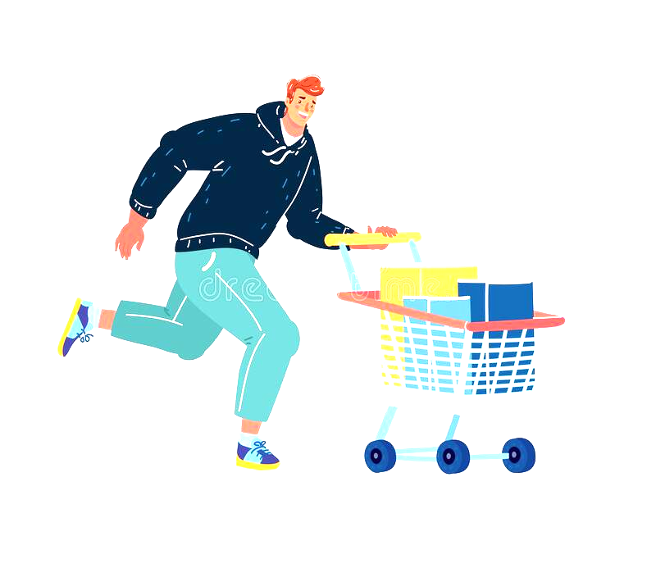

|GRAB ‘N’ GO | Shopping system
GROUP MEMBERS
C341 - AMAAN TAMBOLI
C343 - SUMIT TEKAM
C365 - SAISH KOTHAWADE
C366 - ANUSH SHETTY

Slide 2
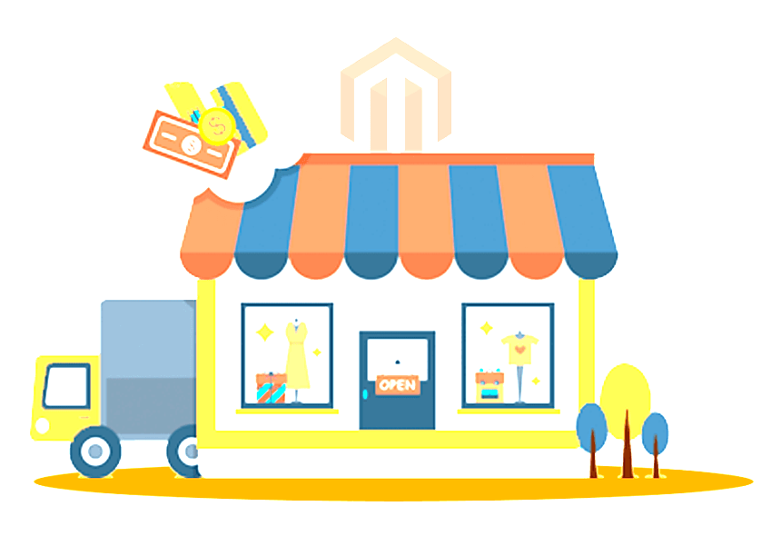
CONTEXT:
Introduction
Features
Modules
Concepts used
Traditional shopping system
Advantages
Flow chart
Conclusion
Reference

Slide 3

INTRODUCTION:
Grab n Go Shopping System is the system to automate the process of ordering and billing of a shop store.
This system is built for fast data processing and bill generation for supermarket customers. It also allows the customer to purchase the items.
Paper work will be reduced and the user can spend more time on monitoring the shop
The system also contains discounts on various products so that the product is offered at discounted price while billing. All the taxes of particular produce are also added.

Slide 4

Features: You ask!! what am i capable of!?
Storing details of products.
Storing Customer details.
Addition and Deletion of Product.
Taxes and Commission of Products.
Discount on particular product.
Billing of the Products.
Dynamic database management

Slide 5

MODULES
Registration
Login
Employee
Stock
Add/remove/edit items
Show item details
Purchase
Customer
Bill report
Show item details
Purchase

Slide 6

OOPs CONCEPTS USED: am i made up of cells???
Objects
Classes
Data abstraction and encapsulation
Inheritance
Polymorphism
File Handling
Function Overriding

Slide 7
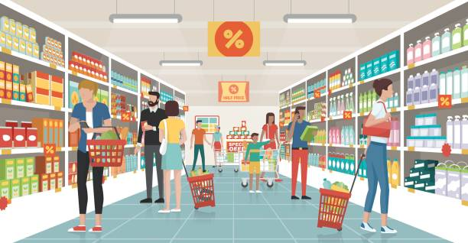
Traditional shopping system: Good old days!?
What's wrong with traditional shopping system
Time consuming.
Poor communication.
Need of Effort.
Needs Large Space.
Finding items.

Slide 8
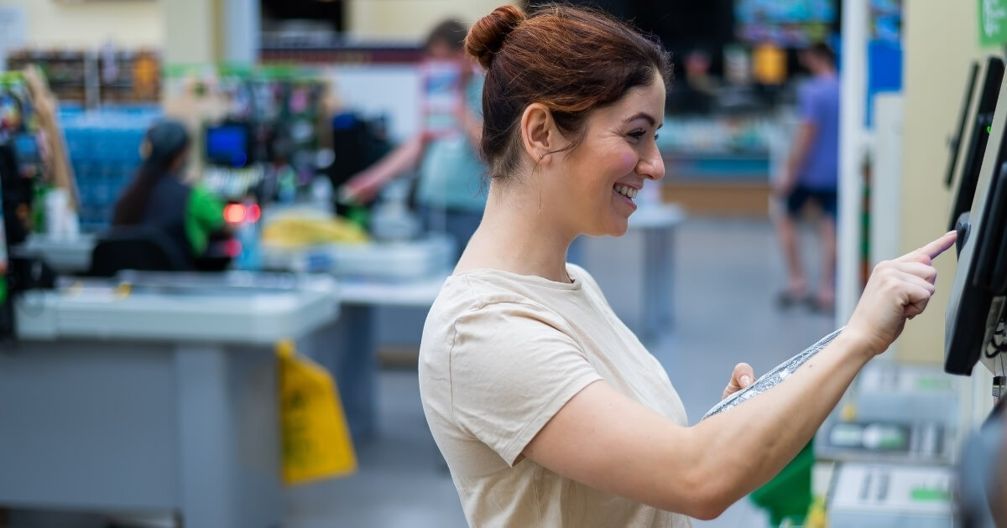
Advantages WHY ME?? CAUSE WHY NOT!!!!
You can purchase the item without entering the shop(contactless shopping).
Bill will be provided in real time within seconds.
Items will be provided by employee as you purchase item.
Here there will be no chance that the product received will be wrong or misplaced as communication is handled by computer.
There would be no chaos.
All data like customer name, employee name, items etc will be stored in organized way (more efficient than paper).

Slide 9
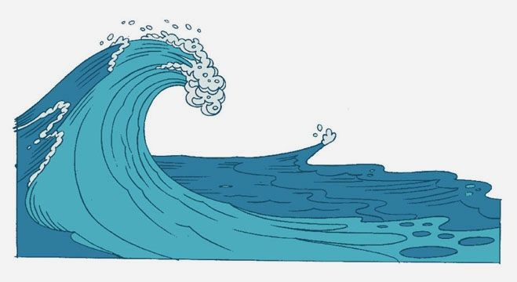
FLOWCHART: LIKE WATER I FLOW!!! SO ELEGANT!

Slide 10
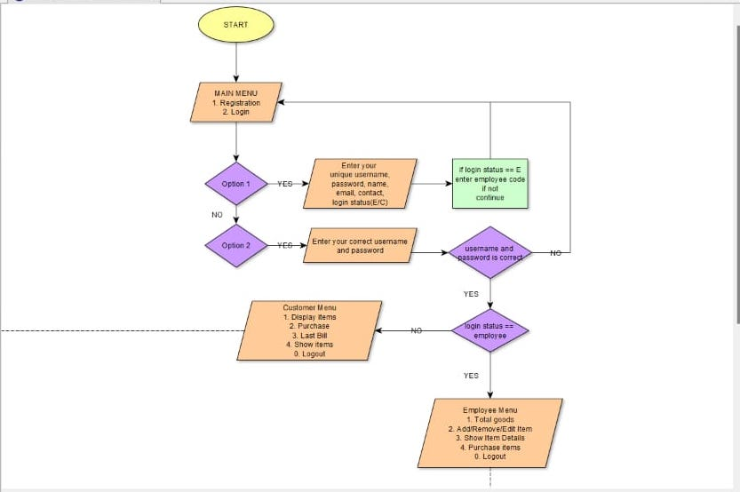

Slide 11
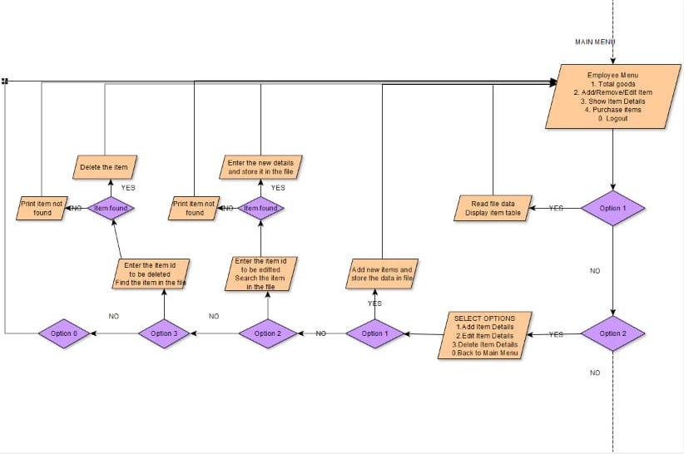

Slide 12
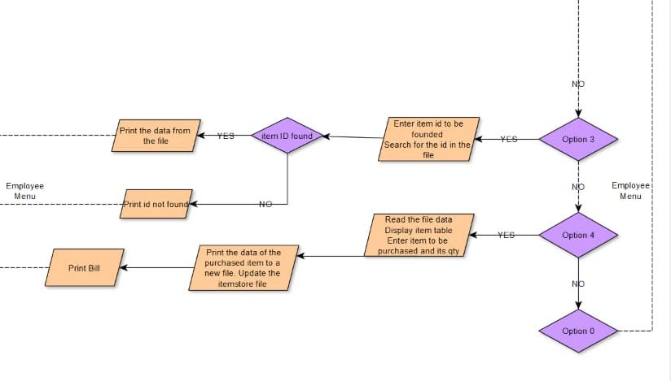

Slide 13
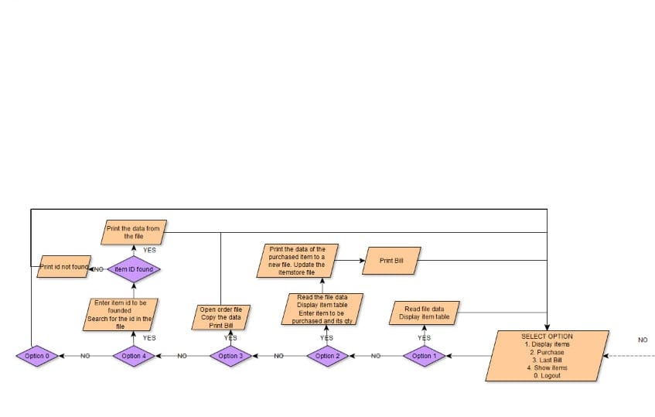

Slide 14
conclusion: bye!!!bye!!
This software is successfully done to maintain a store’s transaction and to save customers as well as shopkeeper’s precious time.
We have learned various OOP tools & features while implementing this project.

Slide 15
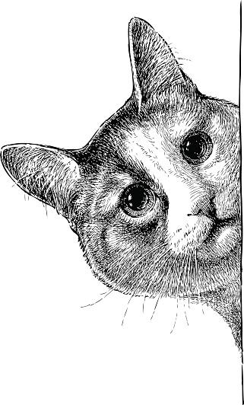
REFERENCE: what's poppin!!don't mind me just watching
https://www.geeksforgeeks.org/
https://www.javatpoint.com/
https://www.tutorialspoint.com/index.htm
https://www.programiz.com/
https://stackoverflow.com/
https://www.youtube.com/

Slide 16

The end:

